Slide 1

Building a Data Science Architecture
12 December 2018
Presented By:
Eric Thornton
For Questions, Comments or Clarifications Contact:
ET@ChameleonMetadata.com

Slide 2
Why Do We Need A Data Science Architecture?
The 80/20 Data Science Dilemma:
A Data Scientist, Data Expert, or whatever your company calls them, typically spend only 20% of their time analyzing datasets. The other 80% of their time is spent finding, cleaning, and reorganizing huge amounts of data, which is an inefficient data strategy ^{[1]}
Only 15% of Big Data Projects Succeed:
In November 2016 Gartner estimated that 60% of big data projects fail. A year later, Gartner’s Nick Heudecker said the 60% estimate was "too conservative“ saying the failure rate was really "[C]loser to 85 percent." ^{[2]}
[1] https://www.infoworld.com/article/3228245/data-science/the-80-20-data-science-dilemma.html
[2] https://www.techrepublic.com/article/85-of-big-data-projects-fail-but-your-developers-can-help-yours-succeed/
Copyright 2018 – Chameleon Metadata

Slide 3
Why Do We Need A Data Science Architecture?
Exposing Tribal Knowledge:
Despite having the technical infrastructure in place, different departments are often reluctant to share their data.
Better Data Governance:
A lack of effective data governance within data lakes prevents users from trusting the system, so they hoard their data instead. As a result, its value is lost to the rest of the company.
Data owners need to have confidence that the data they share will be accessed, used and protected appropriately.
Even if users are persuaded to share their data, it can be difficult to decide:
How to share it
What kind of data cleansing and preprocessing needs to happen before it is safe for others to use.
Most organizations mistakenly believe that answering these questions may require yet another large IT investment.
Cataloging Datasets You Already Have:
Finding datasets with the information needed for hypothesis testing
This issue is often exacerbated when companies treat their data lake as a dumping ground for assets, rather than a well-organized and actively managed archive. In these circumstances, it is difficult for users to find or understand assets within the data lake, and when they do, they are of questionable quality and unknown provenance.
Copyright 2018 – Chameleon Metadata

Slide 4
Case Study - Journal of Petroleum Technology (JPT)
Staff at large energy company told the Journal of Petroleum Technology (JPT) they found their engineers sometimes spent weeks collecting the subsurface, operations, maintenance, and finance datasets needed to do basic analysis on something such as oil well performance.
Their analysts can now bypass the time-consuming data curation process and begin performing analysis much quicker thanks to their integrated data warehouses (IDWs) which serve as centralized data stores for staff involved in various disciplines.
Deployment has resulted in improved well uptime, decreased drilling times, optimized completion designs, and increased understanding of subsurface characteristics, the company says.
But, integrating and making data transparent across multiple functions “requires some governance to make sure we’re applying that data to the right case at the right time,” the company told JPT. “There’s financial information, there’s subsurface information, and there’s production information that, all out of context, could mislead you.
“So we’ve established a data governance process that has identified owners of the data—or functional owners across the business—who we bring together in this collaborative group to discuss the types of data that we’re storing in our warehouse, the access requirements for the data, the conditioning of it, and the various uses to make sure no one is being misled with the application of that data.”
[3] Journal of Petroleum Technology (JPT) - https://www.spe.org/en/jpt/jpt-article-detail/?art=4170
Copyright 2018 – Chameleon Metadata

Slide 5
Robotic Process Automation
The Beatles saved the world from boredom. Can a cutting-edge technology known as Robotic Process Automation (RPA) do the same for the workplace and take the robot out of the human? ^{[4]}
The Robotic Process Automation market is advancing at a rapid clip. “Market growth is exceeding our greater than 50% CAGR to get from $500 million to $2.8 billion in five years,” said Craig Le Clair, an analyst at Forrester. “That’s very unusual.” ^{[5]}
The major benefit we found in the 16 case studies [is] a return on investment that varies between 30 and as much as 200 percent in the first year. But it’s wrong to look just at the short-term financial gains. That approach does not do justice to the power of the software because there are multiple business benefits. ^{[6]}
Python is known for the abundance of excellent libraries backed by large communities of programmers . . .
Why not really leverage all those libraries?
[4] Forbes - https://www.forbes.com/sites/forbescommunicationscouncil/2018/08/15/how-rpa-is-changing-the-way-we-work/#579b7b911047
[5] TechTarget - https://searchcio.techtarget.com/blog/TotalCIO/In-a-hot-RPA-market-the-rule-of-five-keeps-CIOs-focused-on-use-cases
[6] McKinsey - https://www.mckinsey.com/industries/financial-services/our-insights/the-value-of-robotic-process-automation
[Graphic] Deloitte Analysis - https://www2.deloitte.com/content/dam/Deloitte/us/Documents/process-and-operations/us-sdt-process-automation.pdf
Copyright 2018 – Chameleon Metadata

Slide 6
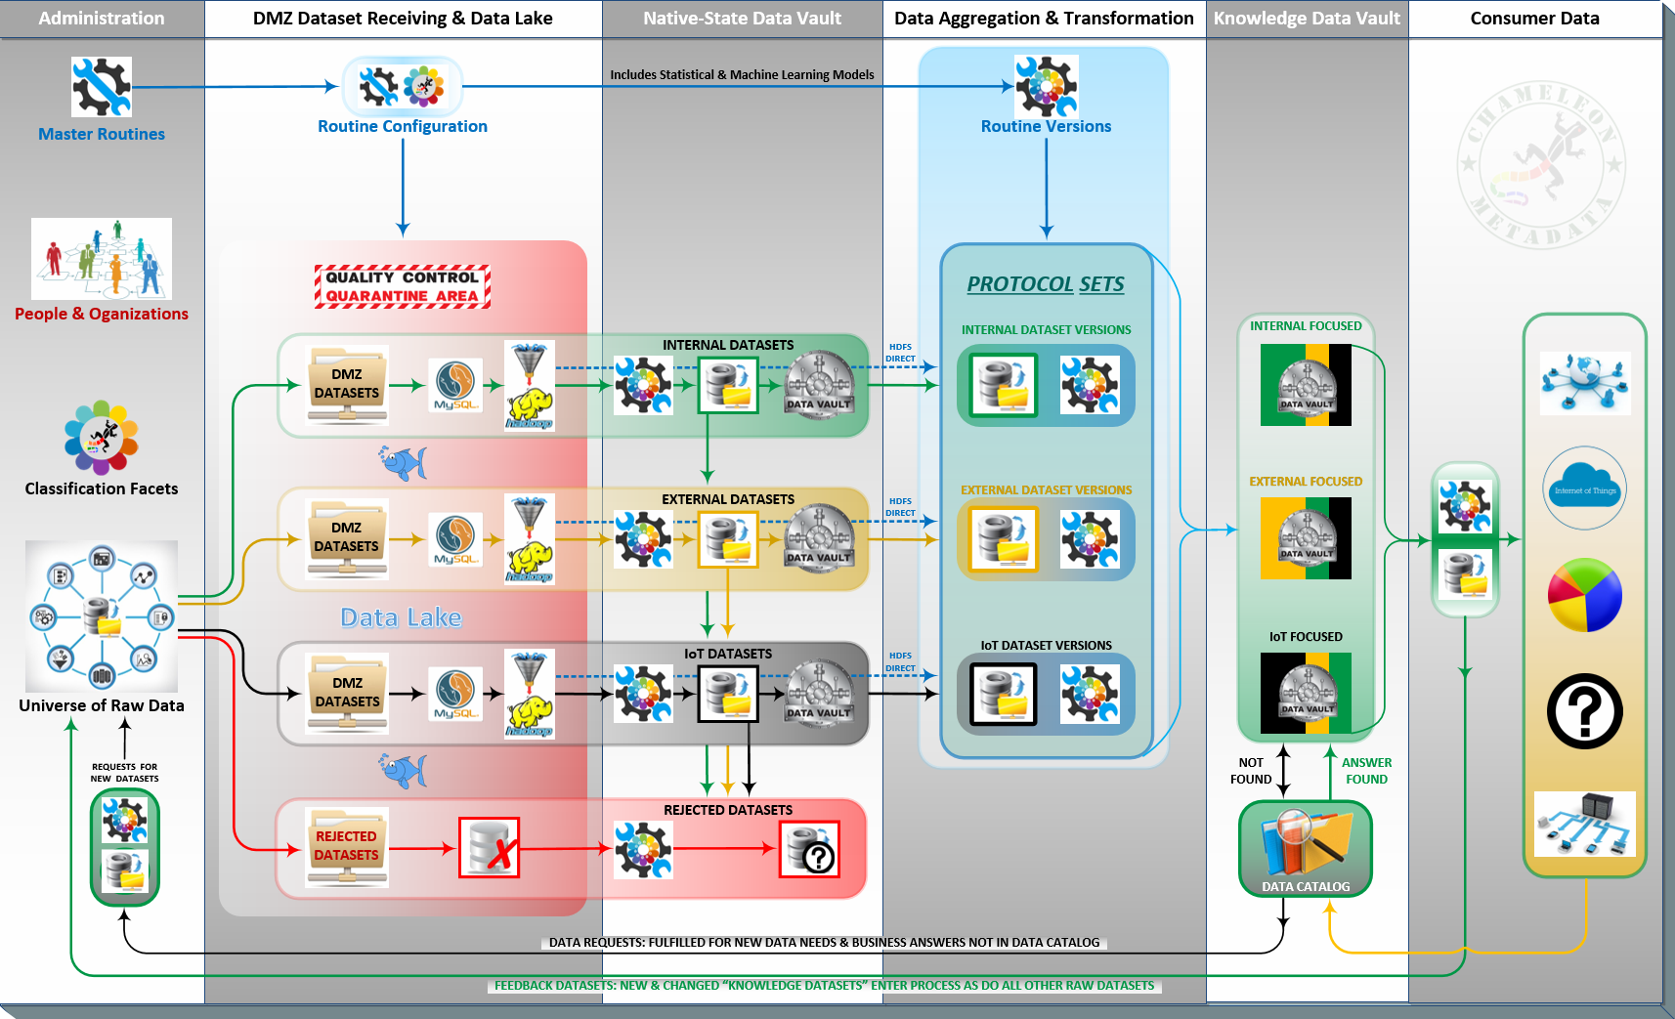
Data Science Architecture Overview
Copyright 2018 – Chameleon Metadata

Slide 7
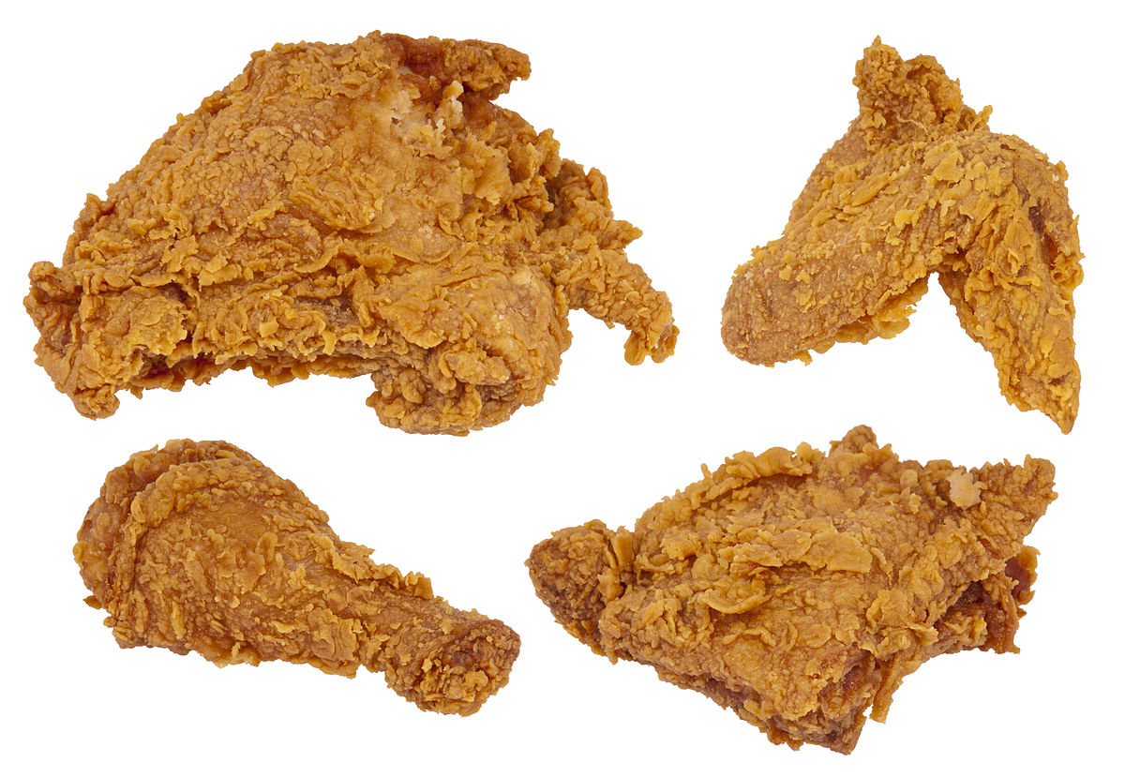

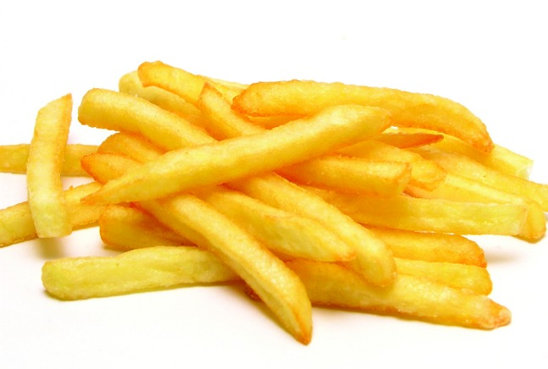
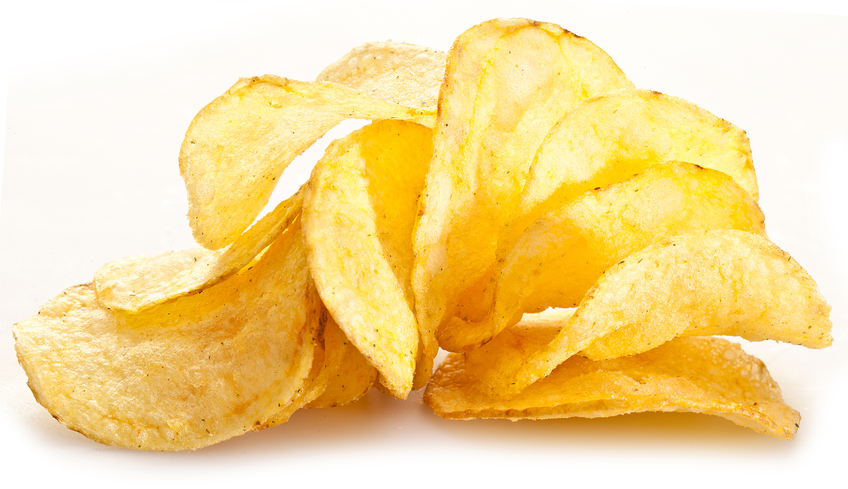
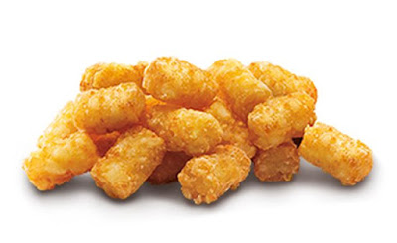
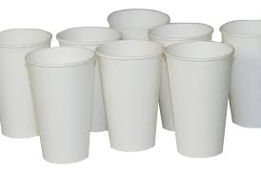

Describing Business Concepts Is Hard
When a business has simple business processes, business concepts are easy to describe
Fried Chicken.
Candy.
French Fries.
Potato Chips.
Tater Tots.
Paper Cups.
Paper Plates.
FOOD PRODUCTS
NON-FOOD PRODUCTS
Copyright 2018 – Chameleon Metadata

Slide 8
Describing Business Concepts Is Hard
But, as a company’s business processes become more complex, business concepts are less simple to describe
FOOD PRODUCTS WITHOUT
POTATOS
Fried Chicken.
Candy.
French Fries.
Potato Chips.
Tater Tots.
Paper Cups.
Paper Plates.
Whereas we only needed one descriptor on the last slide (Food, or Not Food), with the new descriptive requirement, we now need to break the ‘Food’ category down further (Contains Potato ?)
FOOD PRODUCTS WITH
POTATOS
NON-FOOD PRODUCTS
Copyright 2018 – Chameleon Metadata

Slide 9
Describing Business Concepts Is Hard
Potato Chips.
French Fries.
Tater Tots.
Fried Chicken.
Candy.
Paper Cups.
Paper Plates.
Notice that the ways ‘The Business’ groups products change depending on which part of ‘The Business’ is designing the groups (a.k.a. hierarchies)
Finance hierarchies are concerned with groups like ‘Food’ or ‘Non-Food’. Or, not shown here: grouping business units by location: North America; South/Central America; EU; Africa; and Asia/Pacific.
Manufacturing hierarchies are more concerned with materials and logistics (i.e. Frozen/Not Frozen or Contains Potatoes/No Potatoes)
These built-for-purpose hierarchies rarely align across the purpose for which they were specifically designed.
This situation is very common when one company acquires another or a company moves from one ERP or CRM platform to another
Chameleon Metadata’s Flexible Hierarchies Management tools and processes allows us to identify misaligned hierarchies in advance.
‘What If’ hierarchies can be built before they’re needed and verified to identify risks/issues before a formal roll-out into Production.
So, client can ‘see a taxonomy issue’ before it breaks anything.
CONTAINS POTATO
FOOD PRODUCTS
FROZEN
NO POTATOES NO POTATOES
NON-FOOD
Copyright 2018 – Chameleon Metadata

Slide 10
Describing Business Concepts Is Hard
Taxonomies: Common Product Hierarchy Levels
Each product is related to certain other products. The product hierarchy stretches from basic needs to particular items that satisfy those needs. There are 7 product hierarchy types which are most common:
Need family: The core need that underlines the existence of a product family. Let us consider Food as one of needs.
Product family: All the product classes that can satisfy a core need with reasonable effectiveness. For example, all of the products like Frozen, Bakery or Drinks are food families.
Product class: A group of products within the product family recognized as having a certain functional coherence. For instance, Bread is one product class.
Product line: A group of products within a product class that are closely related because they perform a similar function, are sold to the same customer groups, are marketed through the same channels or fall within given price range. For instance, Pasta is one product line.
Product type: A group of items within a product line that share one of several possible forms of the product. For instance, Macaroni is one product type.
Brand: The name associated with one or more items in the product line that is used to identity the source or character of the items. For example, Bertolli is one brand of Pasta.
Item/stock-keeping unit/product variant: A distinct unit within a brand or product line distinguishable by size, price, appearance or some other attributes. For instance Long, Lasagna and Spaghetti are various items under Pasta top product type.
Copyright 2018 – Chameleon Metadata
10

Slide 11
Taxonomies: Product Mix and Product Lines
But organizations often also group the same products into their own distinct ‘units’ because of marketing, technical or end-use considerations. The four most common, non-technical hierarchy types would be:
Width: This refers to how many different product lines the company carries.
Depth: This refers to how many variants, shades, models, pack sizes etc. are offered of each product in the line
Length: This refers to the total number of items in the mix.
Consistency: This refers to how closely the various product lines are related in end use, production requirements, distribution channels or some other way.
Regardless the specifics, companies end up grouping their products, people, process, organizations and locations in a lot of different ways based on the unique needs of the many different groups using it.
Copyright 2018 – Chameleon Metadata
11

Slide 12
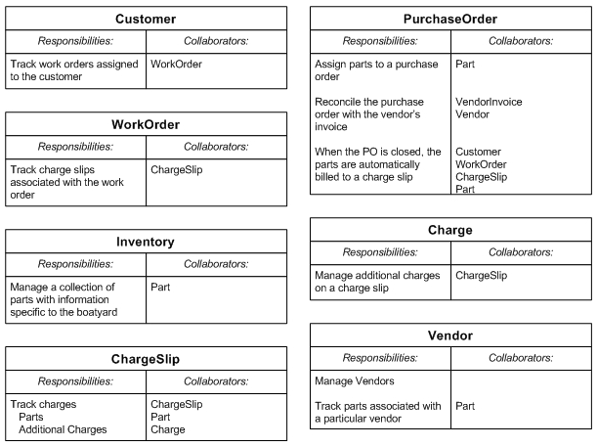
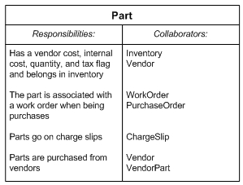
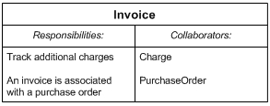
Class, Responsibility, Collaboration Model
Class, Responsibility, Collaboration to start combining the two perspectives
Templates
Copyright 2018 – Chameleon Metadata

Slide 13
SBVR
Copyright 2018 – Chameleon Metadata

Slide 14
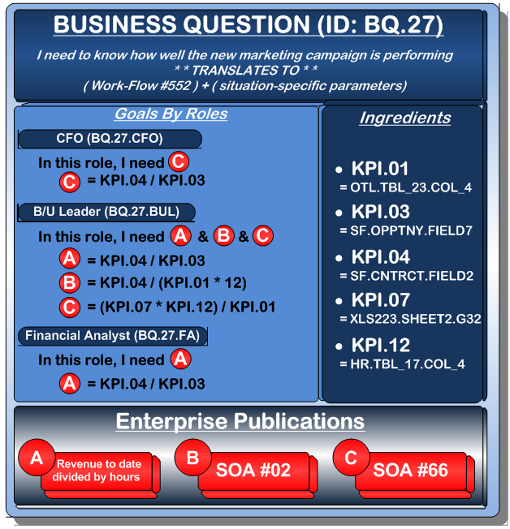
Decision Modeling Basics Adopting ‘Goals by Role’ to Scope Business Question Answers Does the question have ore than one answer ?
How is enrollment going for the Gait Rehabilitation trial (ClinicalTrials.gov ID NCT03995238) ?
The same business question is received differently based on the role of the listener
Some roles need a broad and wide set of measurements to draw a reasonable conclusion
While other roles need fewer, but very specific, granular answers.
Do not attempt to correlate the above to simple or complex – It’s not that easy
But, ‘broad and wide’ is typically a rubric (aggregation) comprised of many specific, granular answers

Slide 15
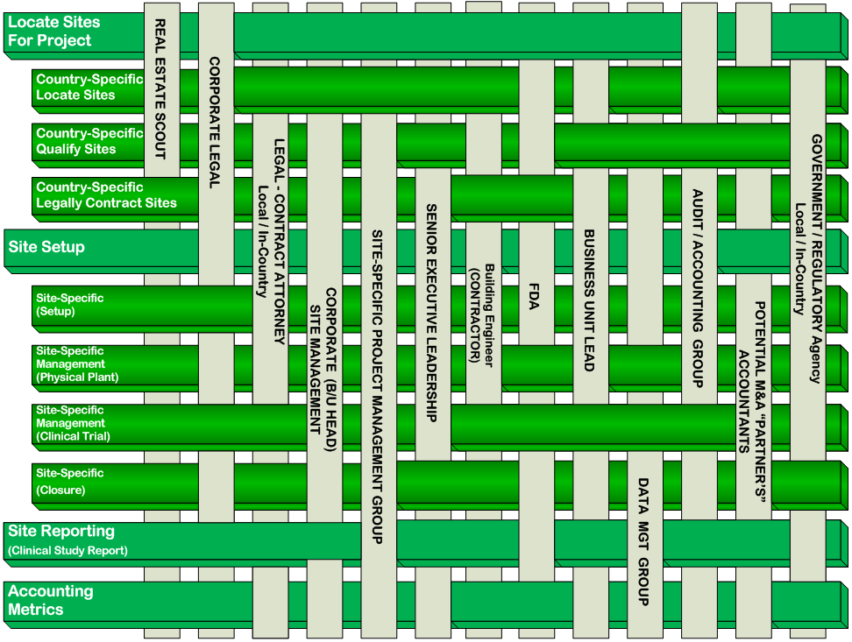
Decision Modeling Basics Associating Roles with Processes Clinical Research Organization Example
Identify ‘broad and wide’ functions first
Identify the roles people will assume whilst doing their function(s)
The Chameleon approach maps functions to roles
Grey above Green performs that function
Grey under Green does not perform that function

Slide 16
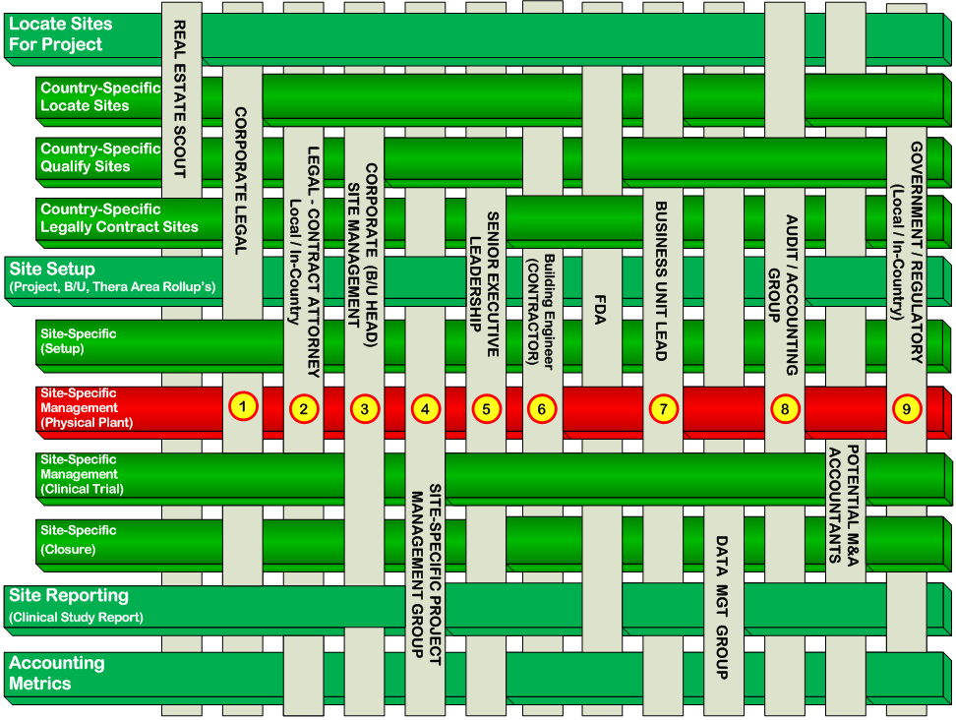
Decision Modeling Basics Associating Roles and Processes Clinical Research Organization Example
Once the relationships between functions and roles has been agreed upon, the data required at a given function-point may be decomposed (see numeric identifiers at right)
Think of intersection points 1-9, in circles to right, as chapters or sections in your catalog of business answers with decision models needed for each

Slide 17
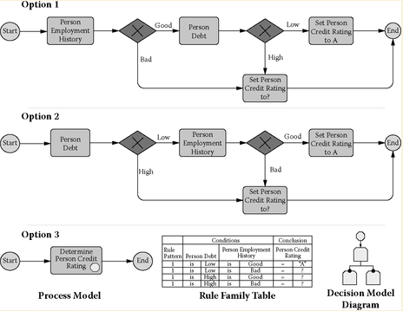
Decision Modeling Basics Associating Roles and Processes
As seen to the right, different teams often do the same set of tasks . . . differently
Option 1 and Option 2 might represent the evolution of a post-merger business processes which have been made functionally similar. The difference in the order of events might be explained by each groups proximity to one of the two required capabilities.
Business Intelligence might project ‘BI facts’ in a way that make both appear to be exactly the same.
By, encapsulating the logic, Option 3 both removes the sequencing required and identifies gaps in understanding
Source: Halle, Barbara von; Larry Goldberg (2009-10-27). The Decision Model. Taylor & Francis - A. Kindle Edition.

Slide 18
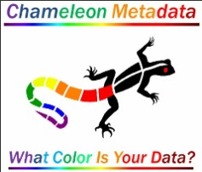
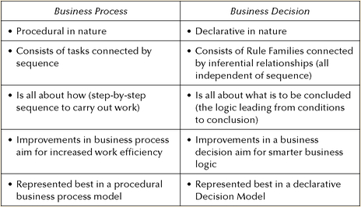
Decision Modeling Basics Rule Families Untangle ‘Business Process’ from ‘Business Decisions’
Traditional process models force unnecessary sequence and constraints in a way that many
end-users find looks wrong
A process model typically does not represent ALL business logic
A process model typically takes a form which is not easy to reuse as they often reflect the input of only one/few of the SME’s using the process daily
A Rule Family implies no particular sequence among the conditions to be tested.
Rule Families link points in a process model with decisions required at each point and hierarchically organizes them as a Rule Family
Source: Halle, Barbara von; Larry Goldberg (2009-10-27). The Decision Model. Taylor & Francis - A. Kindle Edition.

Slide 19
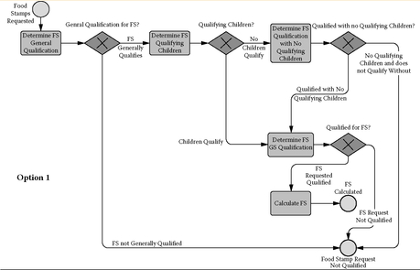
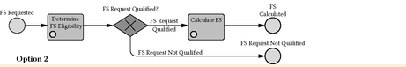
Decision Modeling Basics Taxonomy verses Folksonomy
Two business process models for determining Food Stamp (FS) eligibility are shown at the right
Using Option 1, a sequence of process tasks are forced to occur in a specific sequence which often leads to reliance on ‘tribal knowledge’
Using Option 2, the business decisions are represented by two Rule Families. The decisions are classified as being about eligibility or calculation of the Food Stamp benefit. By encapsulating the decisions, complexity is greatly reduced in the process model
Templates
Source: Halle, Barbara von; Larry Goldberg (2009-10-27). The Decision Model. Taylor & Francis - A. Kindle Edition.

Slide 20
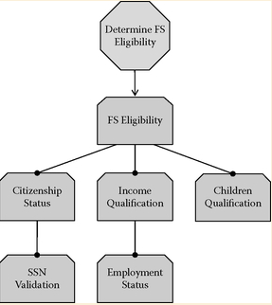
Decision Modeling Basics Taxonomy verses Folksonomy
Traditional business process models may be simplified by removing those parts which can be represented in a declarative Decision Model.
“Determine FS Eligibility” contains business logic from several of the tasks in Option 1
FS Eligibility and Children Qualification from a traditional process model remain
But, decision models also contain:
Citizenship Status, SSN Validation, Employment Status, and Income Qualification
Which are not represented as tasks in the business process model
Traditional process models do not always show all business logic in a process flow.
Templates
Source: Halle, Barbara von; Larry Goldberg (2009-10-27). The Decision Model. Taylor & Francis - A. Kindle Edition.

Slide 21
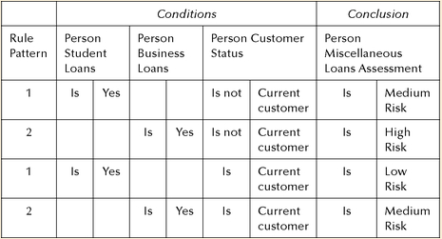
Decision Modeling Basics
Once we are able to express the business decisions in terms of Rules, it is possible to create a ‘Truth Table’ in the form shown at right.
A collection of rules may be referred to as a Rule Family which may be thought of as a method of documenting all the authorized [Circumstance/Outcome] possibilities
The second and fourth rows only consider whether a person is a current customer and whether the person has business loans
A person who is not a current customer with a business loan carries a higher risk than does a person who is a customer with a business loan
Not all three types of conditions need to be evaluated to reach a conclusion about Person Miscellaneous Loans Assessment. Rows one and three evaluate a different set of two conditions than do rows two and four.
Source: Halle, Barbara von; Larry Goldberg (2009-10-27). The Decision Model. Taylor & Francis - A. Kindle Edition.

Slide 22
Decision Modeling Basics Decision Models May Be Normalized
First Normal Form
Second Normal Form
Third Normal Form
No Rule Family row may be decomposed into more than one rule conclusion.
A Rule Family row makes one conclusion and does not contain any conclusions nested inside it.
A Rule Family row cannot be decomposed into more than one such judgment, which has implications for how to represent OR, OTHERWISE, and ELSE among conditions.
Decision Models in
Second normal form eliminate functional (i.e. Inferential) dependencies involving only part of the condition key of a Rule Pattern.
A Rule Pattern is in second normal form only if the conclusion is fully functionally dependent on the entire condition key.
The purpose of third
normal form for the Decision Model is to eliminate functional, (i.e.. Inferential) dependencies among conditions.
A Rule Pattern is in third normal form if it is in second normal form and none of the conditions are transitively functionally dependent on other conditions.
In other words, there are no hidden interim decisions in the Rule Family.
1
2
3
Source: Halle, Barbara von; Larry Goldberg (2009-10-27). The Decision Model (Kindle Locations 1176-1180). Taylor & Francis - A. Kindle Edition.

Slide 23
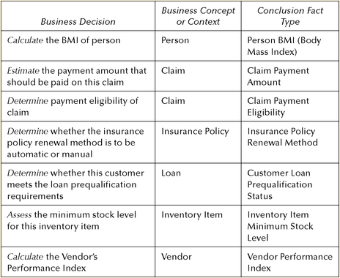
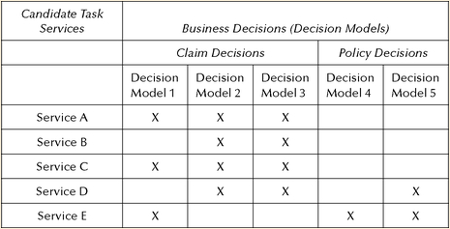
Decision Modeling Basics
Once we are able to express the business decisions in terms of Rules, it is possible to create a ‘Truth Table’ in the form shown at right.
A collection of rules may be referred to as a Rule Family which may be thought of as a method of documenting all the authorized [Circumstance/Outcome] possibilities
Templates
Once we are able to express the business decisions in terms of Rules, it is possible to create a ‘Truth Table’ in the form shown at right.
Source: Halle, Barbara von; Larry Goldberg (2009-10-27). The Decision Model (Kindle Locations 1176-1180). Taylor & Francis - A. Kindle Edition.

Slide 24
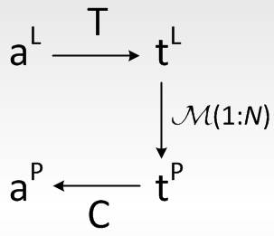
Manipulating Data
a^{L} (check attribute B for NOT NULL)
T (from the Template library)
t^{L} (as Logical Template – i.e. checking PATIENT_ID for NOT NULL)
M(t^{L} : t^{P}) (Many Physical Templates per Logical Template – i.e. Talend or INFA)
t^{P} (Physical Template – i.e. Talend 6.4 vs. Talend 7.0 workflow)
C (Conditions passed to t^{P} which make it a ‘Physical Activity’)
a^{P} (Physical Activity – i.e. A Talend 7.0 workflow with all parameters and conditions provided)
Mechanism for mapping logical activity to physical implementation
Notes:
Referenced: Alkis Simitsis, Deciding the Physical Implementation of ETL workflows, IBM Almaden Research Center

Slide 25
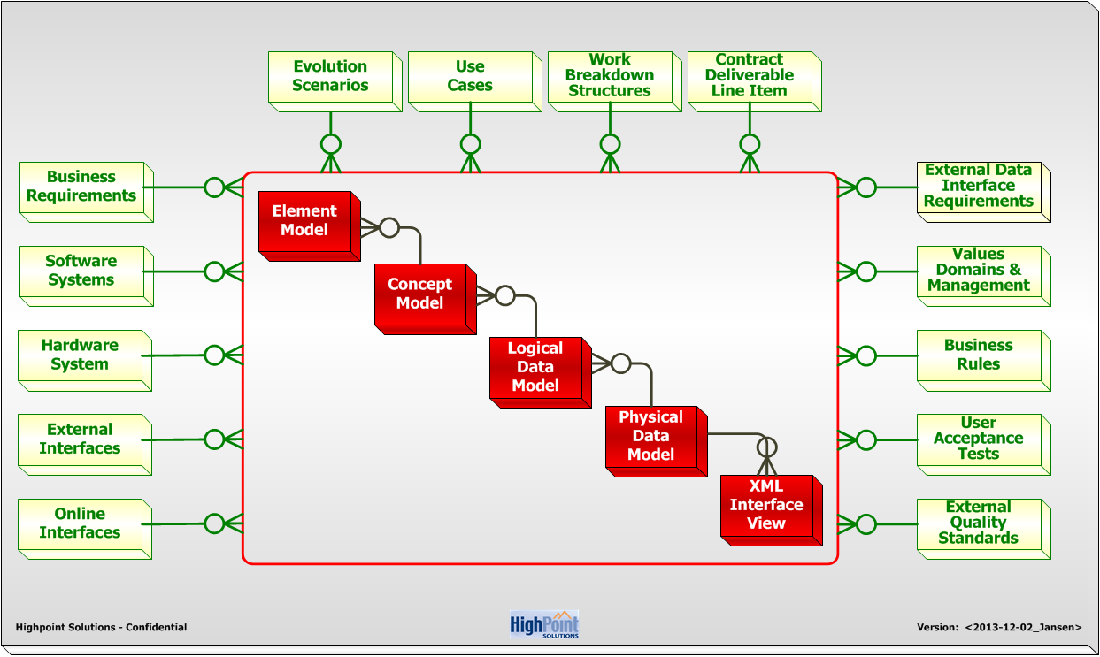
Business Information System Components (BISC)
XML-to-Physical (XML Views inherit from only 1 Physical Model – But, M XML from 1 Physical )
Physical-to-Logical (1 Physical may be comprised of M Logical Models)
Logical-to-Concept (1 Logical may be comprised of M Concept Models), etc.
TDAN 13898

Slide 26
Element to BISC XREF
Business Information System Components (BISC)
TDAN 13898

Slide 27
Element to BISC XREF
Business Information System Components (BISC)
TDAN 13898

Slide 28
Element to BISC XREF
Business Information System Components (BISC)
TDAN 13898

Slide 29
Element to BISC XREF
Business Information System Components (BISC)
TDAN 13898

Slide 30
Element to BISC XREF
Business Information System Components (BISC)
TDAN 13898

Slide 31
Element to BISC XREF
Business Information System Components (BISC)
TDAN 13898

Slide 32
Associating BISC to Roles and Processes Clinical Research Organization Example
Once the relationships between functions and roles has been agreed upon, the tasks required at a given function-point
may be decomposed
(numeric identifiers at right)
Only now are we ready to design a . . .
Decision Model
Templates

Slide 33
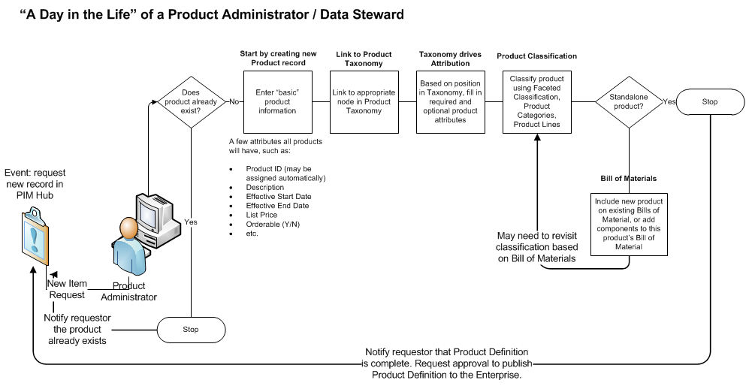
Chameleon Metadata Basics – Micro Processes
Templates

Slide 34
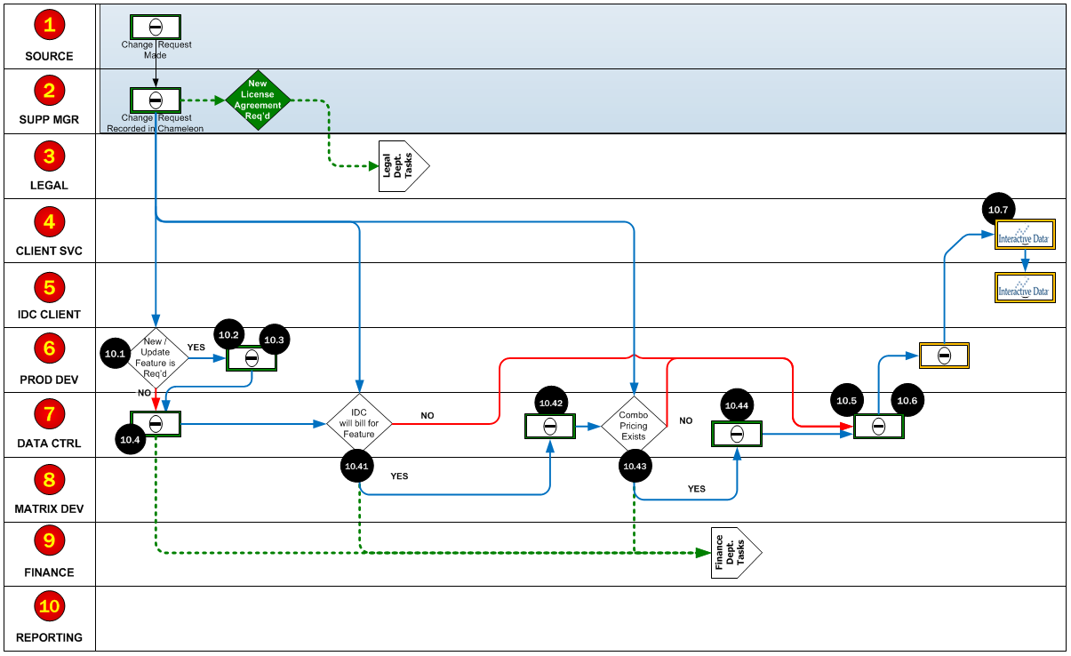
Associating BISC to Roles and Processes The 10 Rows Below^{(Yellow # in Red)} Represent A Single Intersection on Previous Slide(Black # in yellow fill – See Inset)
Inset: View of Lattace Slide
CLIENT
CLIENT
CLIENTS
Templates
SUBSCRIPTIONS

Slide 35
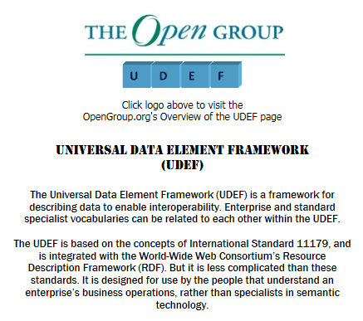
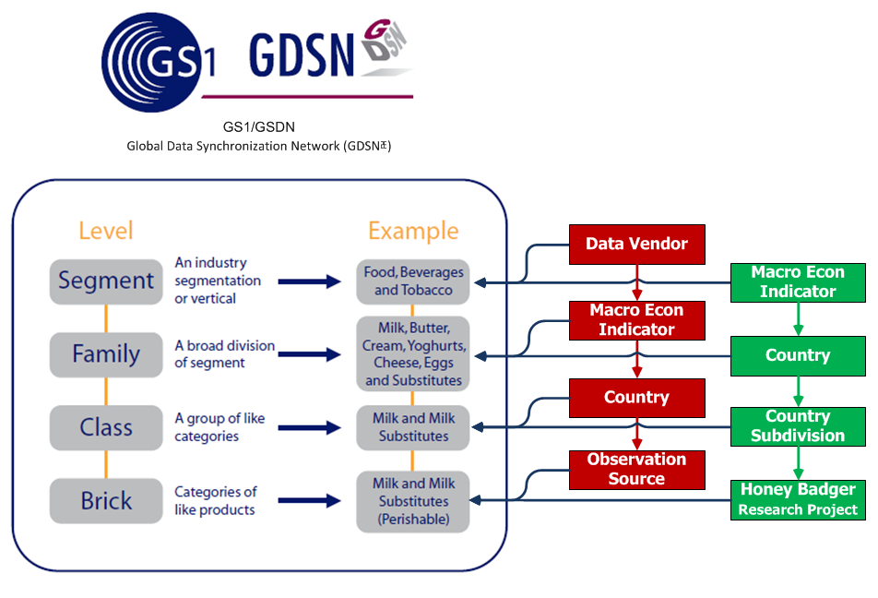
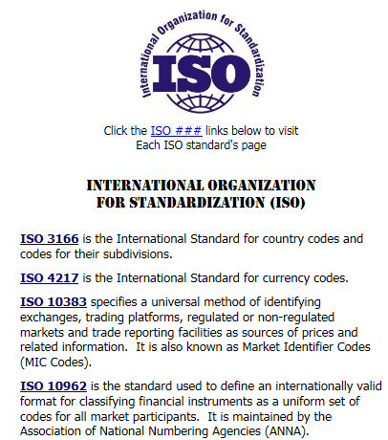
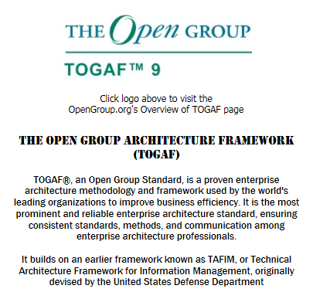
Chameleon Metadata Basics – Always Open Source 1st
Templates

Slide 36
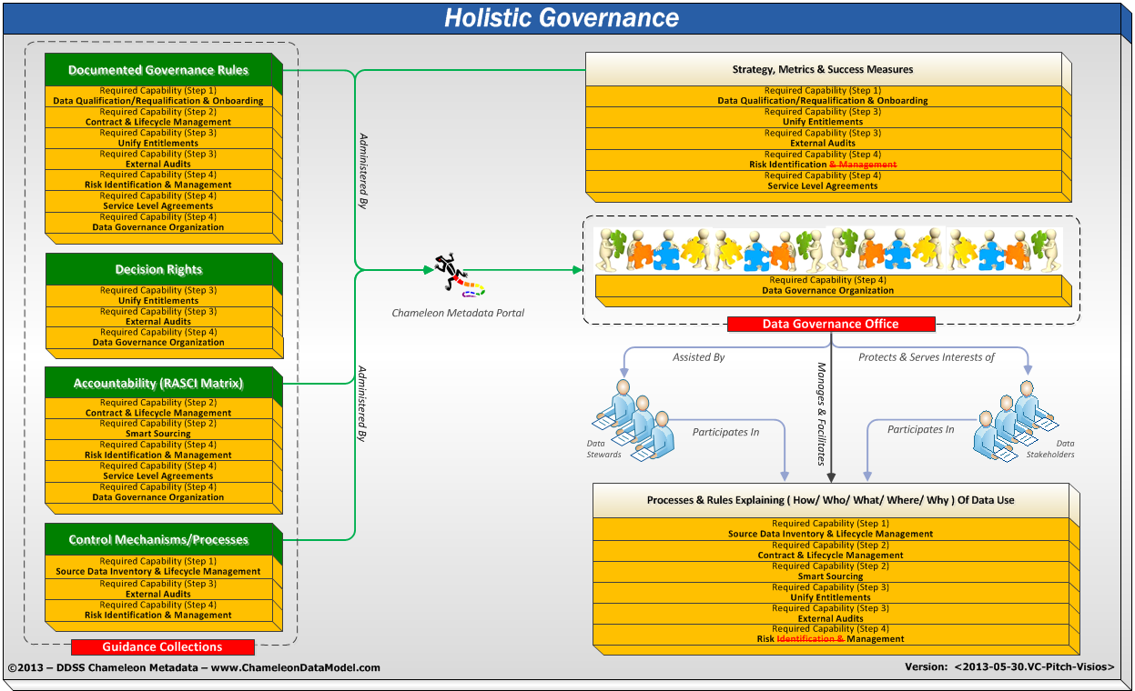
You Need Governance
Templates

Slide 37
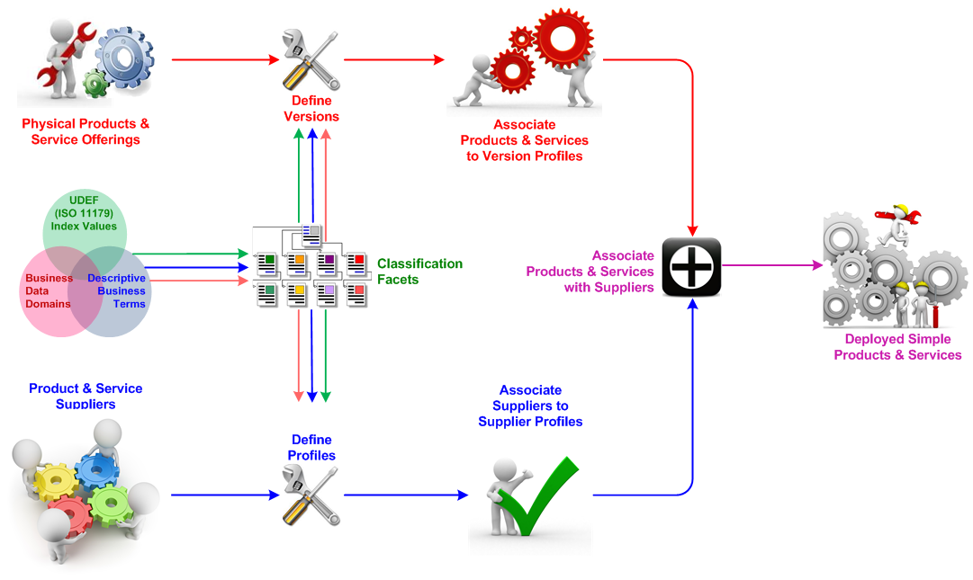
Chameleon Metadata Basics Product Master (i.e. Crayon) may have many Versions (Red, Blue and Green Crayon) Supplier Master (i.e. Wendy’s Wax) may also have many versions (Standard Supplier as V1 & DoD certified as V2)
Templates

Slide 38
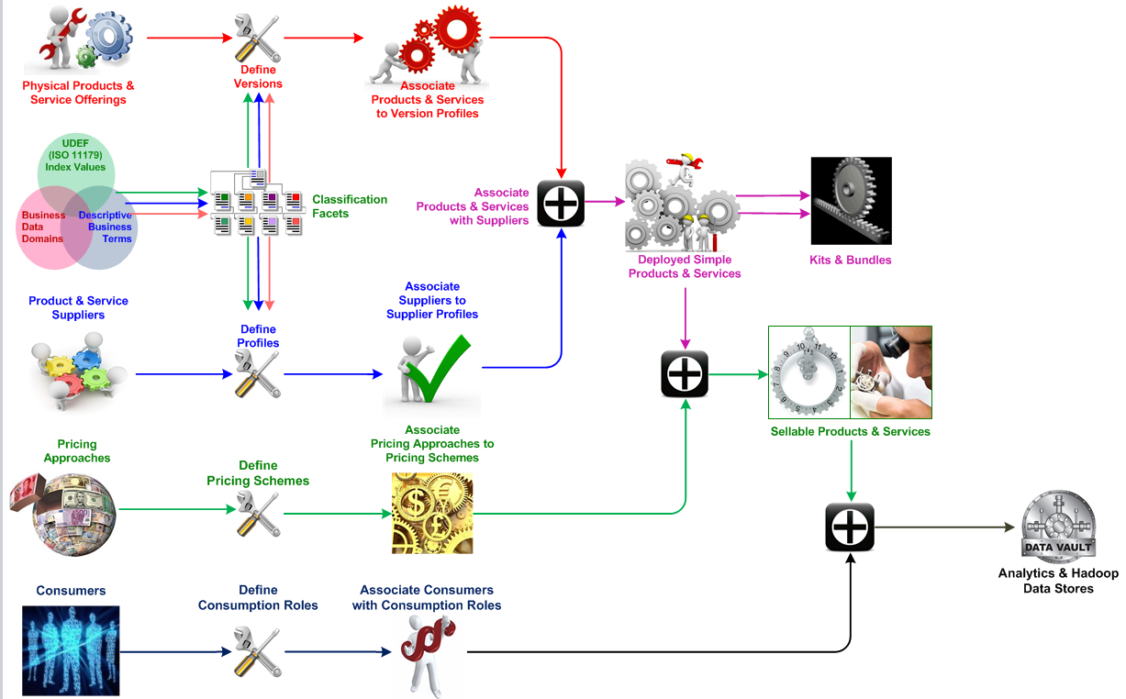
Chameleon Metadata Basics Everything should be ‘Plug & Play’, kind of like Lego Blocks
Templates

Slide 39
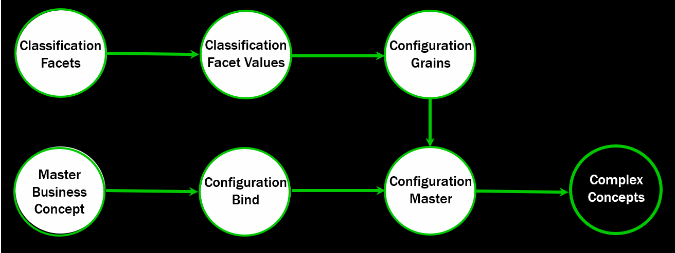
Identifying Entities Using Features
Master Entities – High-level business concepts
Proposal, Employee, Opportunity, Certification, etc.
Configuration Master Entities – Versions of or ‘roles’ an entity may assume – primarily a label
The GLOBEX may be INITECH’s client, vendor or both depending on the transaction relating them
Configuration Grain Entities – A collection of attribute values which, when taken as a group, uniquely identify a single Configuration Master.
Taken as a group, {First_Name + Last_Name + Birthdate + ZIP Code} uniquely ID a person to almost 6 std. deviations
Configuration Bind Entities – Relates a Master entity to Configurations or Versions of itself
The City of Cambridge, MA is Bound to two (2) Configurations which appear the same, but one has ‘DPW’ in its name
Copyright 2018 – Chameleon Metadata

Slide 40
Identifying Data Using Relationships
Data links are identified by more than one Entity Occurrence sharing the same Classification Facet Value(s)
Copyright 2018 – Chameleon Metadata

Slide 41
Identifying Data Using Relationships
This approach also positions your organization to start using Graph Databases (like Neo4j)
[Source] Neo4j - https://neo4j.com/graphgist/bank-fraud-detection
Copyright 2018 – Chameleon Metadata

Slide 42
Data Science Architecture Overview - Revisited

Slide 43
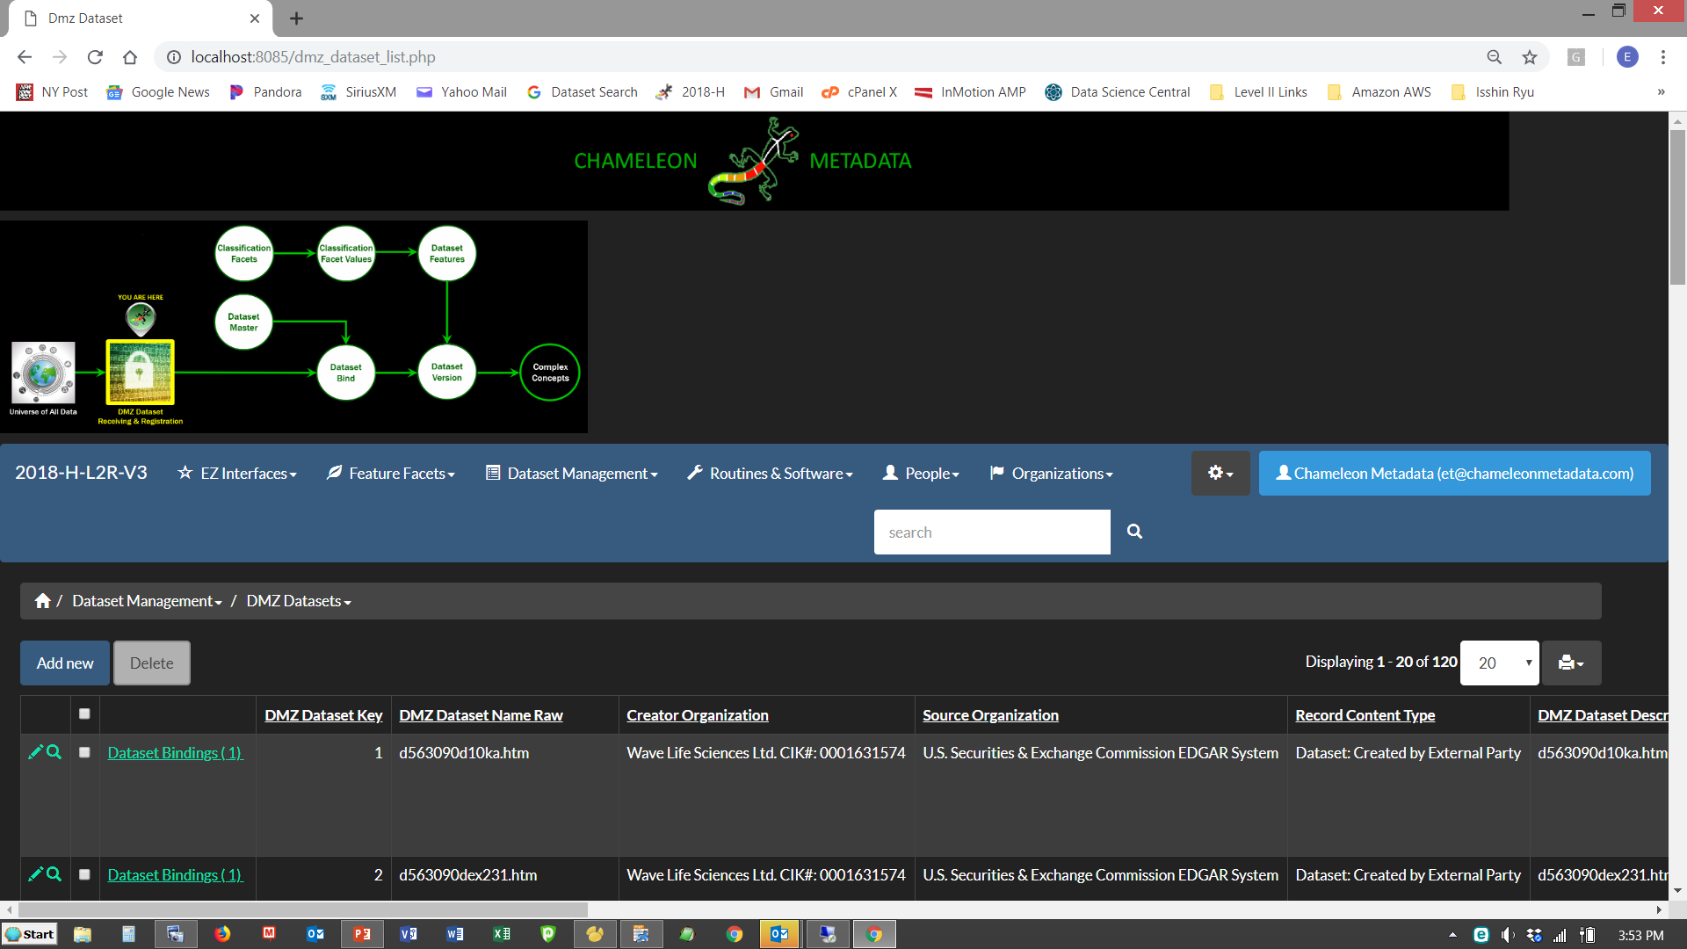
Entities Roles Using Feature Combinations
Copyright 2018 – Chameleon Metadata

Slide 44
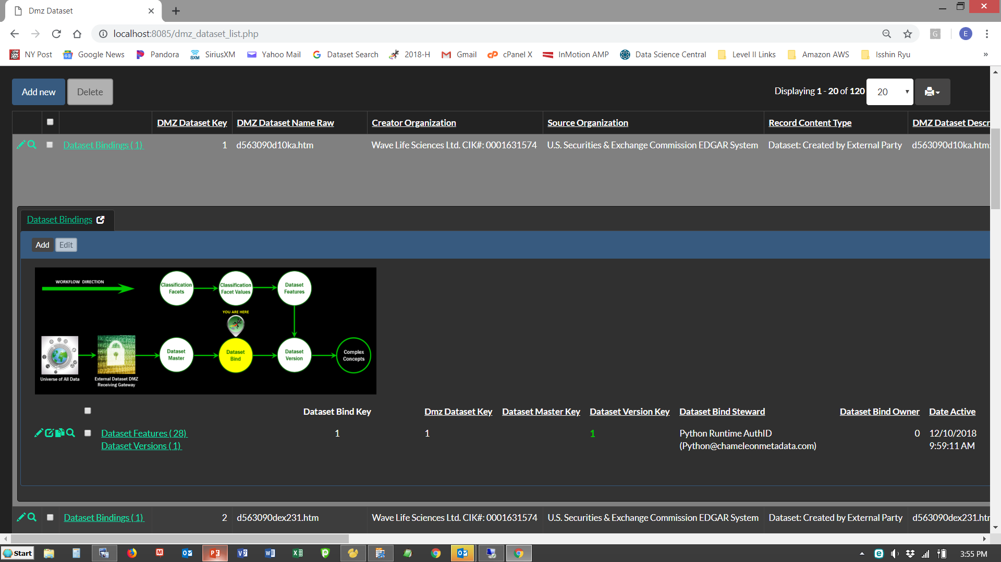
Entities Roles Using Feature Combinations
Copyright 2018 – Chameleon Metadata

Slide 45
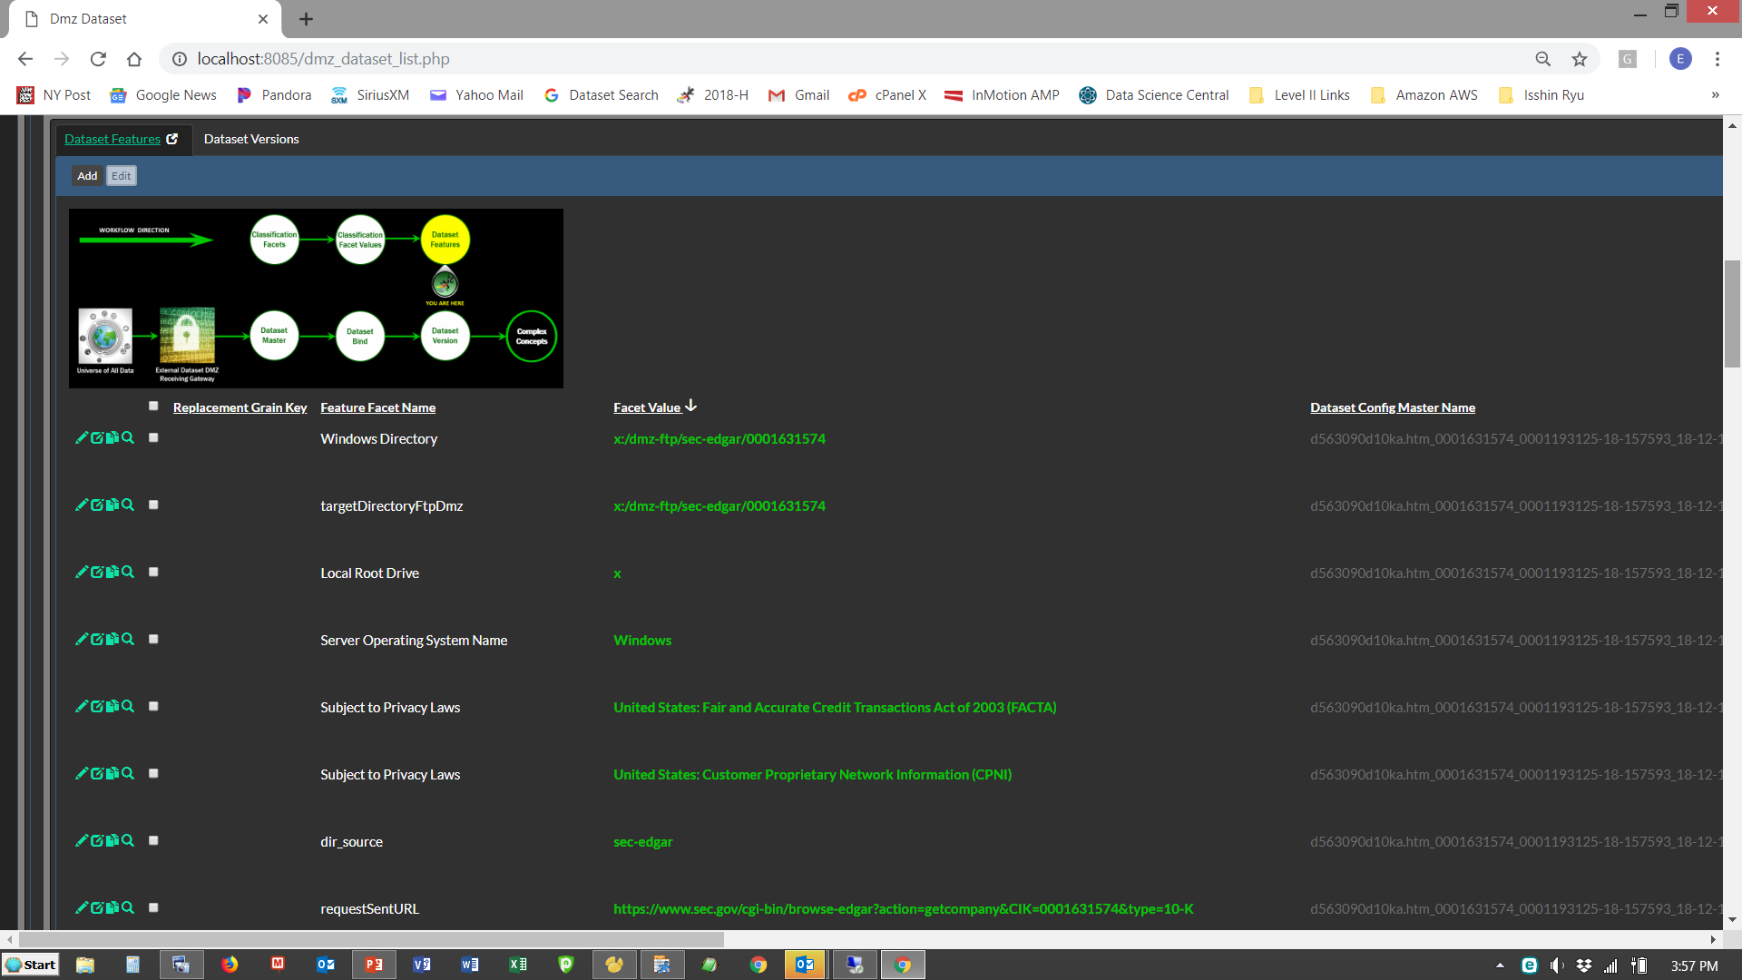
Entities Roles Using Feature Combinations
Copyright 2018 – Chameleon Metadata

Slide 46
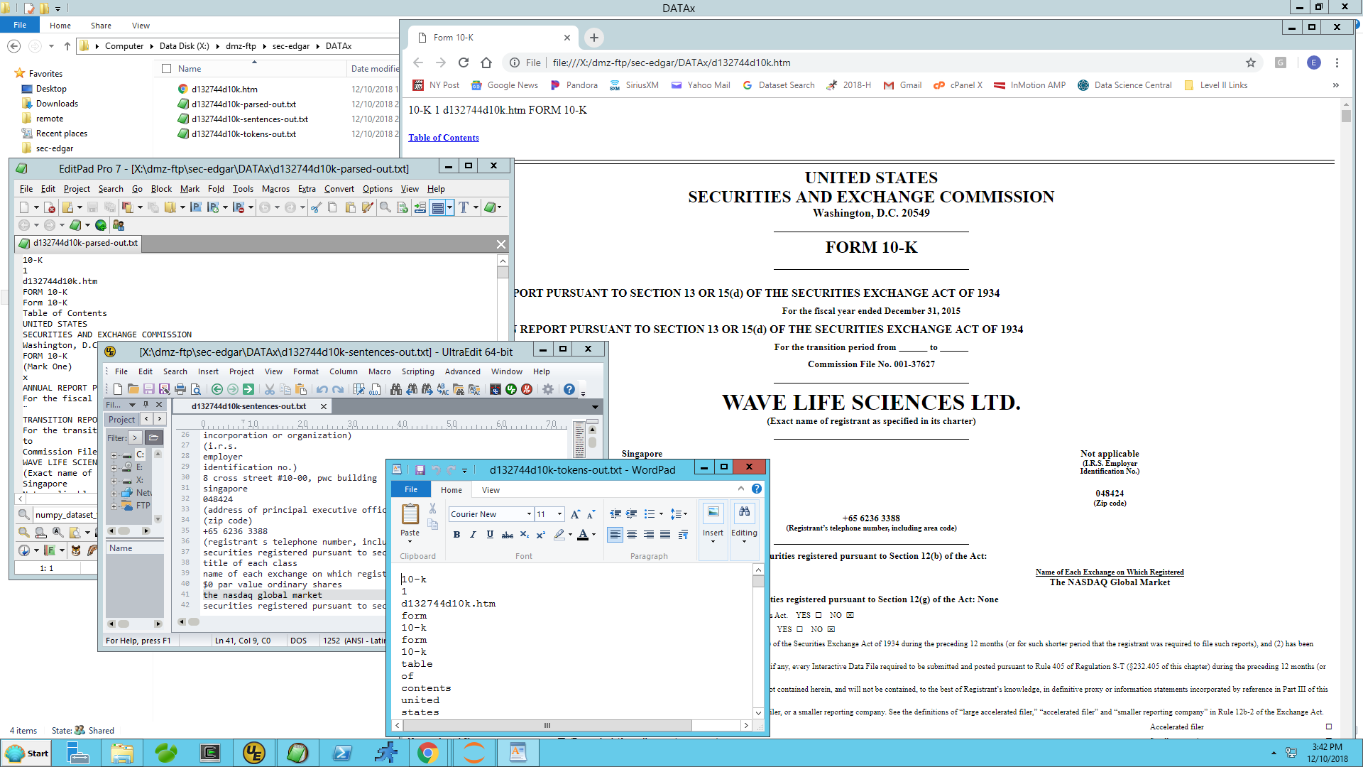
Preprocessing Spawns Many Child-Datasets
Copyright 2018 – Chameleon Metadata

Slide 47
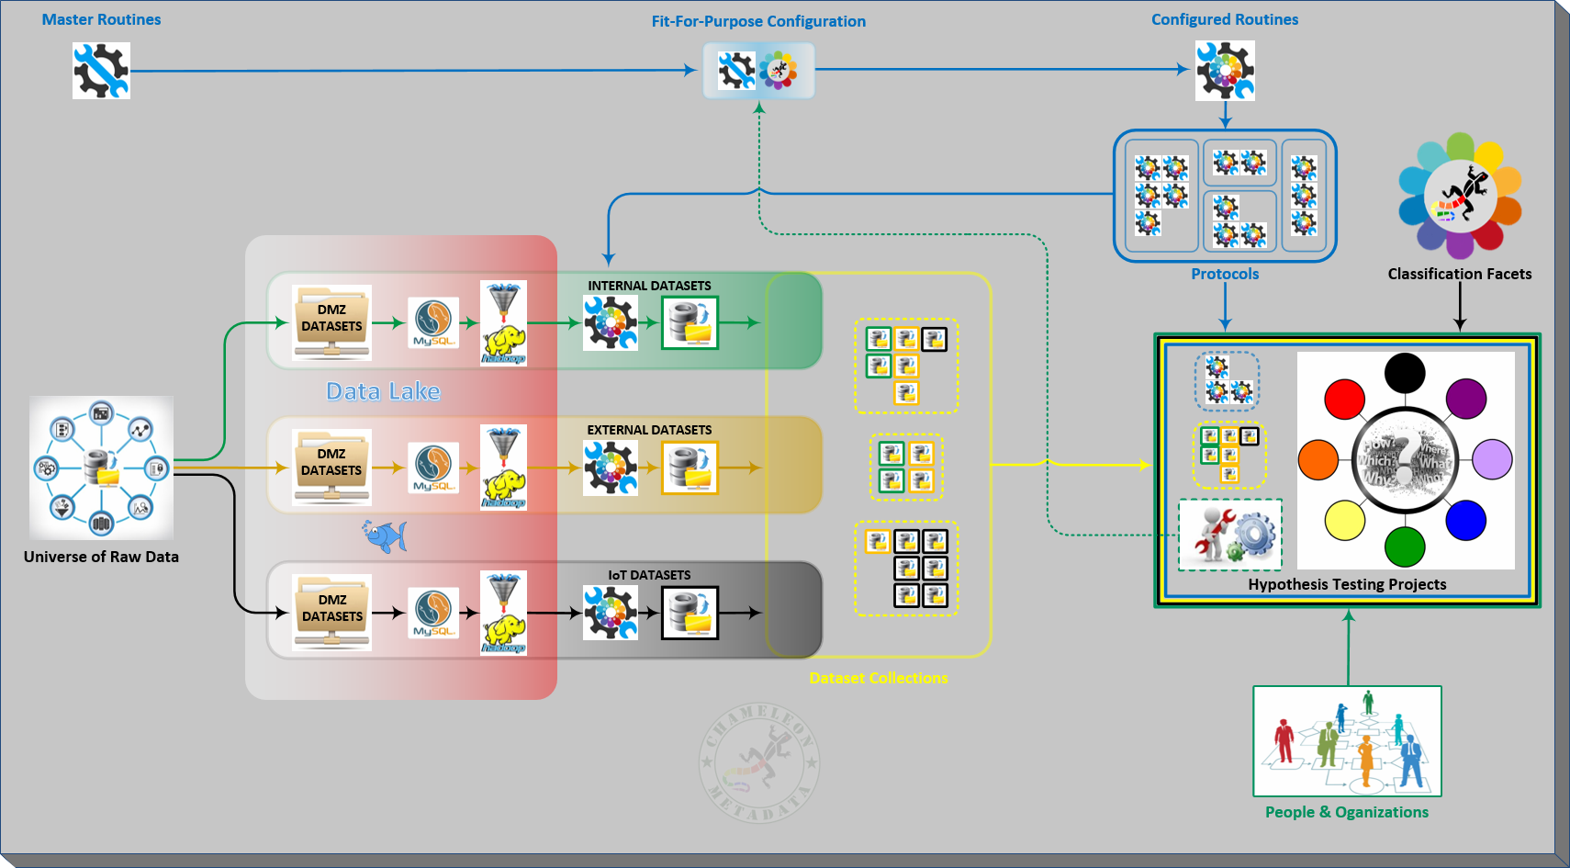
Data Analysis & Hypothesis Testing Needs Many Datasets
Copyright 2018 – Chameleon Metadata

Slide 48
Data Science Architecture Overview - Revisited

Slide 49
Have A Solid Plan . . . For Keeping Your Initiative Funded

Slide 50



It’s An Iterative Process – Don’t Try And Do It All Day-1
10-K & 10-KA Filings 1st ?
Copyright 2018 – Chameleon Metadata
50

Slide 51


Copies of the Python Code Are Available At Our GitHub Site:
https://github.com/chameleonmetadata/DATAx_NYC_2019
For Questions, Comments or Clarifications Contact:
ET@ChameleonMetadata.com
New York: (+1) 646.688.5566
London: (+44) 020.7096.8920
Copyright 2018 – Chameleon Metadata
51

